Slide 1
Drawing causal conclusions from observational data
Linying Zhang

Slide 2







AGENDA
13:00 – 13:30 | Estimation in observational research
13:30 – 14:15 | Drawing causal conclusions from observational data
14:15 – 14:45 | Interactive session on study design
14:45 – 15:00 | Break
15:00 – 15:30 | Cohort method and diagnostics
15:30 – 16:00 | Meta-analysis and negative controls
16:00 – 17:00 | Study execution: cohort building, Strategus, interpret

Slide 3
A motivating example
GLP-1 receptor agonists are primarily used to treat type 2 diabetes, and have recently seen more widespread use because they can also help reduce weight.
Although all antidiabetic drugs help reduce the risk of cardiovascular outcomes, it is yet unclear what the effect of GLP-1s is on acute myocardial infarction compared to other antidiabetic drugs.

Slide 4
Population-level effect estimation
Question: Do GLP-1s reduce the risk of acute myocardial infarction more than DPP-4 inhibitors?
Let’s unpack this question…
Comparison: comparing risks of [outcome] between [target] and [comparator] during a [time at risk]
T (target exposure): GLP-1
C (comparator exposure): DPP-4 inhibitors
O (outcome): acute myocardial infarction (AMI)
TAR (time at risk):
“on-treatment”: risk window ends at treatment discontinuation
“intent-to-treat”: risk window ends at the end of observation
Task: extracting causal effect estimates from observational data

Slide 5

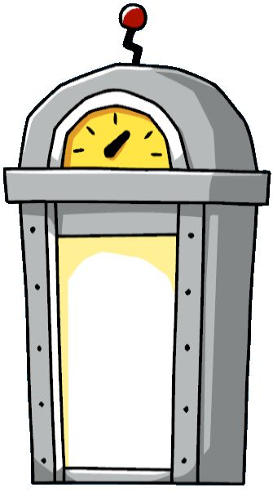
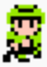

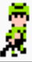
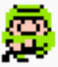

Causal effect estimation: counterfactual reasoning
Cohort summary
Outcome summary
GLP-1RAs
DPP-4 Inhibitors

Slide 6
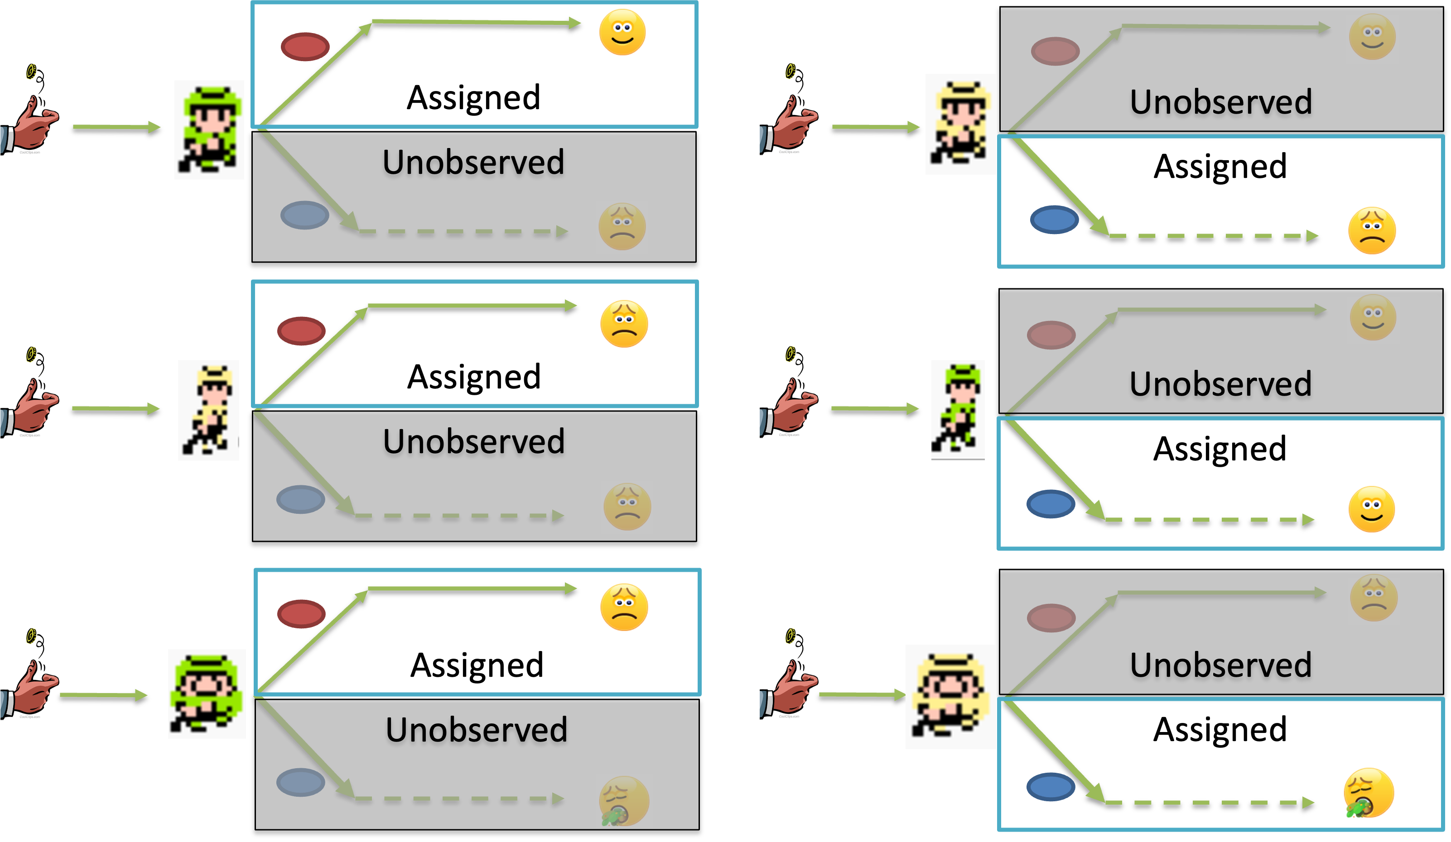
But we don’t have a time machine… randomize to approximate counterfactual
GLP-1RAs
DPP-4 Inhibitors
Randomize patients to T and C: probabilistically balance baseline characteristics
Then can assume T and C cohorts are exchangeable and causally comparable

Slide 7
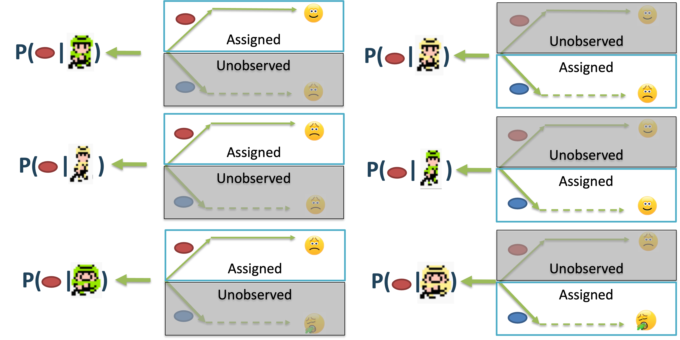
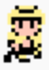
But we can’t even randomize in observational studies! Use propensity score to learn treatment assignment
GLP-1RAs
DPP-4 Inhibitors
If = 0.7, = 0.68, then and are similar and comparable!
P( | )
P( | )
Notes:
Key issue is: T and C groups may not be comparable at all! Receiving different treatments because characteristics are just different!
Propensity score for a subject is the probability that this subject receives the target treatment given their baseline characteristics; it’s a personalized metric, a 1-number summary of the subject’s characteristics relevant to treatment assignment. If two subjects’ have very similar propensity scores, then they are very similar when it comes to treatment assignment and thus very comparable in terms of their treatment effects/outcomes.

Slide 8
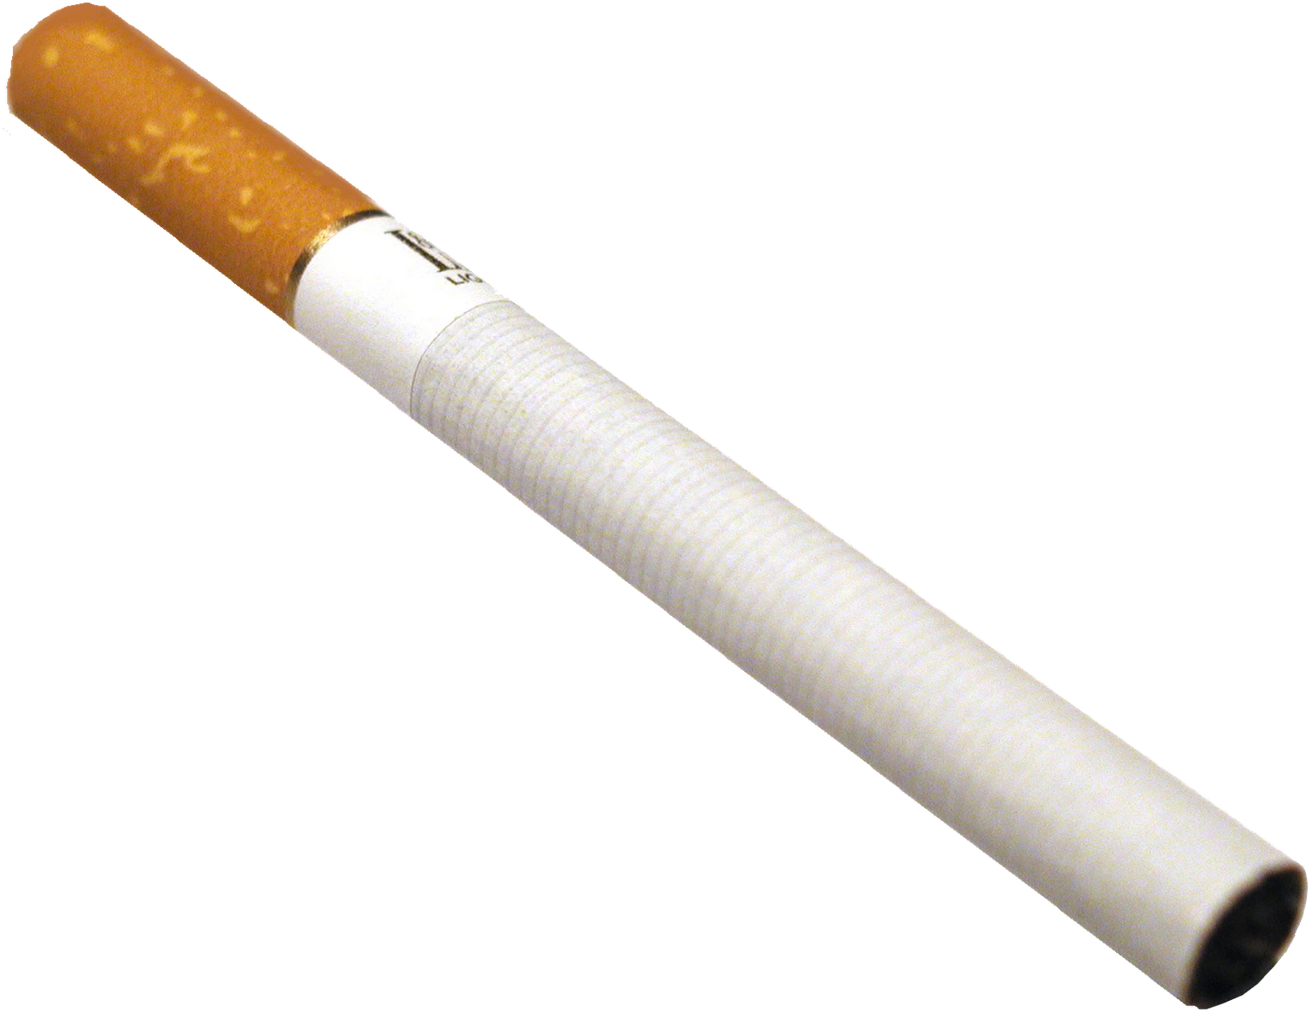
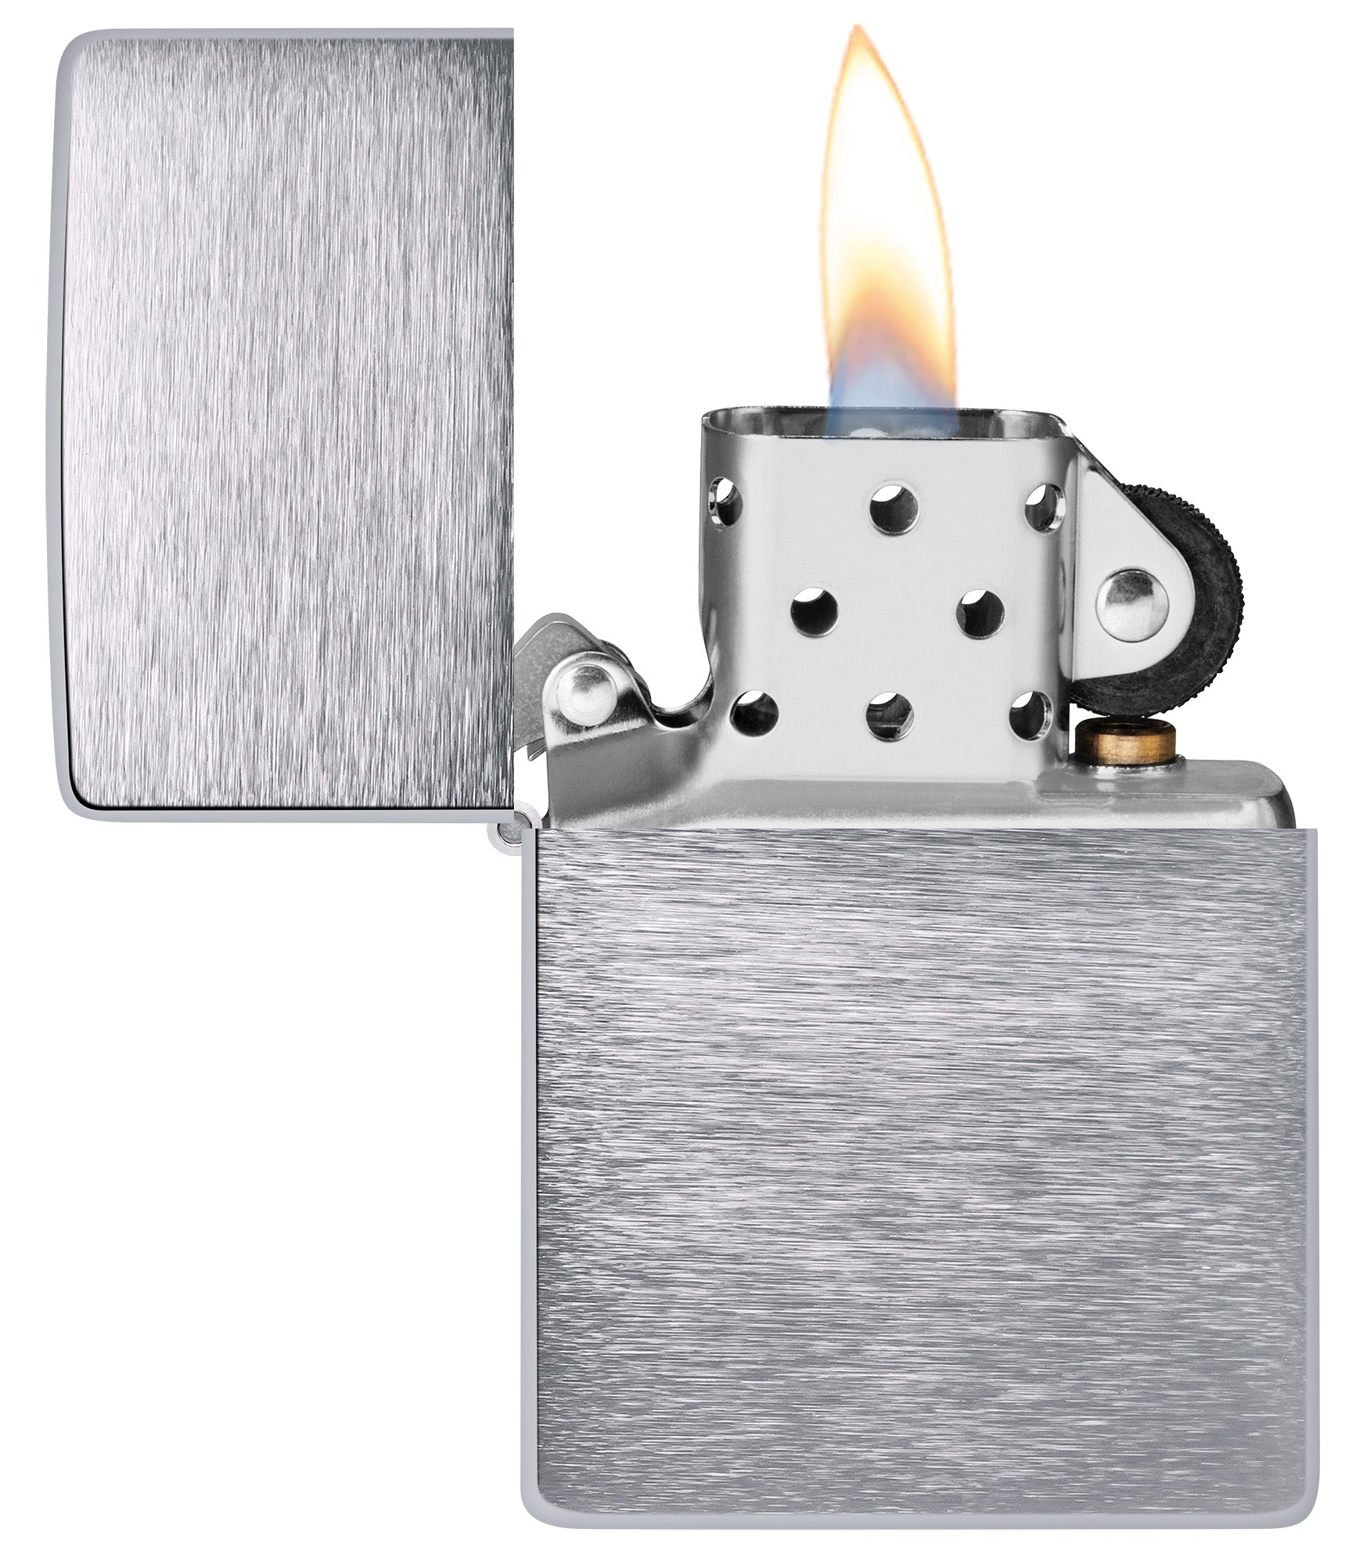

Association is not causation
Confounder is a variable that is associated with both exposure and outcome.
Confounder
?
Exposure
Outcome
Notes:
The reason is that there is confounding bias. For example, if I were going to study the effect of carrying matches on the risk of getting lung cancer. The treatment is not randomized, and people who are smokers are more likely to carry matches around, and we know that smoking causes lung cancer. So in this study, smoking status is a confounder. Without adjusting for smoking, I would get a wrong answer that carrying matches increases the risk of getting lung cancer. So in order to reduce confounding bias, we need to adjust for all confounders in our study.

Slide 9
Association is not causation
Confounding remains one of the major challenges to causal inference with observational data.
What variables are confounders?
Confounders
Age
Sex
Obesity
Diabetes
Hypertension
HbA1c
BMI
Blood pressure
….
?
GLP-1 vs DPP-4
AMI
Exposure
Outcome
Notes:
The reason is that there is confounding bias. For example, if I were going to study the effect of carrying matches on the risk of getting lung cancer. The treatment is not randomized, and people who are smokers are more likely to carry matches around, and we know that smoking causes lung cancer. So in this study, smoking status is a confounder. Without adjusting for smoking, I would get a wrong answer that carrying matches increases the risk of getting lung cancer. So in order to reduce confounding bias, we need to adjust for all confounders in our study.

Slide 10
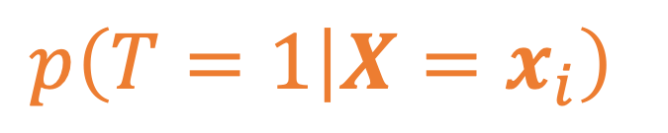
Propensity score for confounding adjustment
exposure
confounders
$$p\left(T=1 | {X=x}_{i}\right)$$
propensity score (PS)
Propensity score is the probability of a patient receiving the target exposure given the patient’s baseline characteristics.
Notes:
So how can we adjust for confounders? Propensity score is a popular method for that.
Propensity score is the probability of a patient receiving the treatment given the patient’s baseline characteristics.

Slide 11
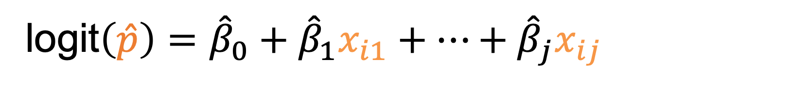
Propensity scores can be estimated from data
logit$\left(\hat{p}\right)={\hat{β}}_{0}+{\hat{β}}_{1}x_{i1}+…+{\hat{β}}_{j}x_{ij}$
propensity score
“confounders”
In practice, propensity score is often estimated with a logistic regression.
Exposure status is regressed on baseline covariates that are believed to be confounders.
Notes:
True propensity scores are not observed, but can be estimated from the data. In practice, PS is often estimated with a logistic regression. The input to the propensity score model include covariates that are believed to be confounders.

Slide 12
Using propensity scores to remove confounding bias
Propensity scores can be used in various ways to remove confounding.
Matching
Stratification
Inverse probability treatment weighting (IPTW)
Notes:
PS can then be used in several ways to remove confounding bias.
For example, in matching, each treated patient is matched with the control patient with the closest propensity score. Matching on propensity score helps to balance the treatment and control groups, reducing the influence of confounders on the effect estimate.
PS can also be used in other ways like stratification and IPTW.

Slide 13
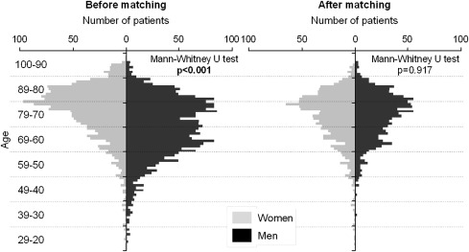
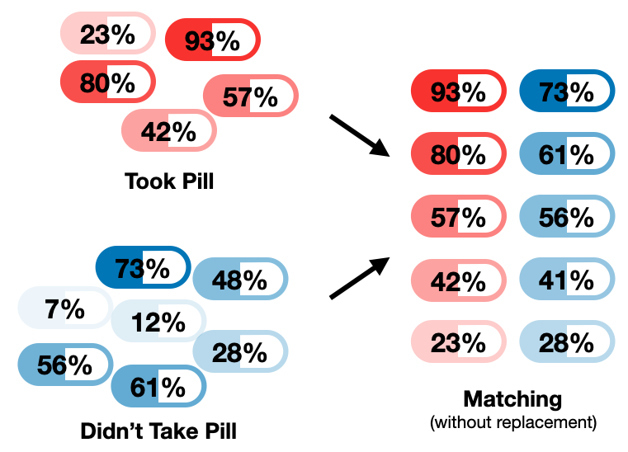
Propensity score matching
GLP-1
DPP-4
GLP-1
DPP-4
DPP-4
Matching on the propensity score creates comparable groups of treated and untreated patients with similar distributions of observed covariates.
Rosenbaum & Rubin. Biometrika. 1983
Image credit Shawhin Talebi.
Notes:
PS can then be used in several ways to remove confounding bias.
For example, in matching, each treated patient is matched with the control patient with the closest propensity score. Matching on propensity score helps to balance the treatment and control groups, reducing the influence of confounders on the effect estimate.
PS can also be used in other ways like stratification and IPTW.

Slide 14








How are confounders selected?
~50,000 concepts
What variables are confounders?
Demographics
Diagnoses
Drugs
Procedures
Labs
Confounder
Age
Sex
Obesity
Diabetes
Hypertension
HbA1c
BMI
Blood pressure
….
Domain Knowledge
Literature Review
Empirical association
?
GLP-1 vs DPP-4
AMI
Notes:
The reason is that there is confounding bias. For example, if I were going to study the effect of carrying matches on the risk of getting lung cancer. The treatment is not randomized, and people who are smokers are more likely to carry matches around, and we know that smoking causes lung cancer. So in this study, smoking status is a confounder. Without adjusting for smoking, I would get a wrong answer that carrying matches increases the risk of getting lung cancer. So in order to reduce confounding bias, we need to adjust for all confounders in our study.

Slide 15
Large-scale propensity score (LSPS)
Include all pre-treatment covariates from the database
Use L1-regularization (Lasso) to reduce overfitting
Advantages:
Minimizes the risk of omitting an important confounder
Reduces subjective decisions and researcher bias in covariate selection
Scalable and interoperable across institutions and datasets
All covariates except
Mediators (pre-treatment only)
Simple colliders (pre-treatment only)
“Instruments” (diagnostics, domain knowledge)
M-structure collider (no bias if its causes are measured and adjusted)
Tian Y et al. Int J Epidemiol. 2018.
Zhang et al. J Biomed Inform. 2022.
Notes:
The reason is that there is confounding bias. For example, if I were going to study the effect of carrying matches on the risk of getting lung cancer. The treatment is not randomized, and people who are smokers are more likely to carry matches around, and we know that smoking causes lung cancer. So in this study, smoking status is a confounder. Without adjusting for smoking, I would get a wrong answer that carrying matches increases the risk of getting lung cancer. So in order to reduce confounding bias, we need to adjust for all confounders in our study.

Slide 16
Assumptions are an integral part of causal inference
Diagnostics
Exchangeability/Unconfoundedness/ignorability
No unobserved confounder
Positivity/Overlap
Every patient has a nonzero probability of receiving each treatment
Stable unit treatment value assumption (SUTVA)
No interference between individuals
Consistency (No hidden variations of the treatment)
Negative controls
Covariate balance
Equipoise in PS distribution
Study design
Phenotyping

